Slide 1

IST 722 Fudge Corporation Subdivisions – Fudgemart & Fudgeflix
Group 2
Anupama Mohan Rao
Harshil Mehta
Janani Athimamula
Manideep Kannaiah
Vidushi Mishra
Yaksh Shobhavat

Slide 2


Company Overview
FUDGEMART
FUDGEFLIX
An e-commerce website like Ebay, target, Ulta etc.
A spin-off of movie rental services like Netflix, Hulu, HBO etc.

Slide 3
Objectives
Merge business process of Fudgemart and Fudgeflix
Satisfy customer needs
Identifying business processes that helps in optimization.
Use data-driven dashboards to identify preferred products.

Slide 4

Business Processes Used
Product Line Profitability
Order Fulfillment
Customer Satisfaction (Reviews and Ratings)
Product Inventory
Sales analysis and reporting

Slide 5
Tools & Processes
Sentimental Analysis
Tool used: jupyter notebook (python)
Output: positive, negative, neutral sentiments.
ETL
Tool used: Microsoft Visual Studio (SSIS)
Processes: Extract, Transform, Load
Building Cubes
Tool used: Microsoft Visual Studio (SSAS)
Processes:
Business Intelligence
Tool used: PowerBI
Processes: Creating visualizations and interactive dashboards

Slide 6
Sentimental Analysis
Extracting Tweets
Removing Stop words
Score each word of the tweet based on dictionary table
Decide the sentiment(positive/negative/neutral feedback) based on average score
Average the score of words for each tweet

Slide 7
Cubes

Slide 8
Our Schema

Slide 9
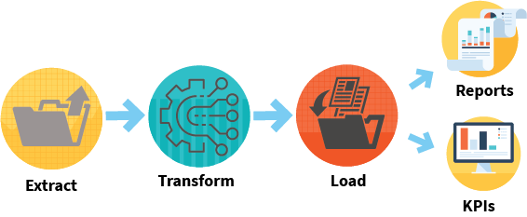
ETL Process

Slide 10
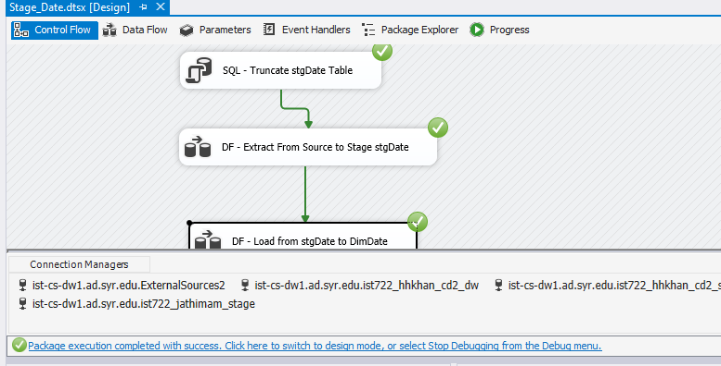
Source to Date Dimension

Slide 11
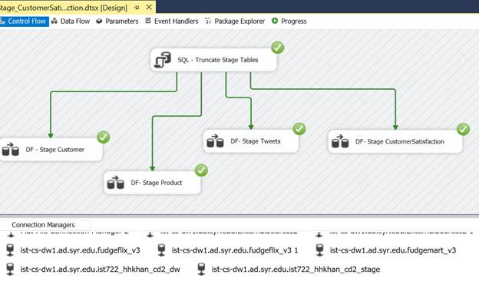
Source to Stage

Slide 12
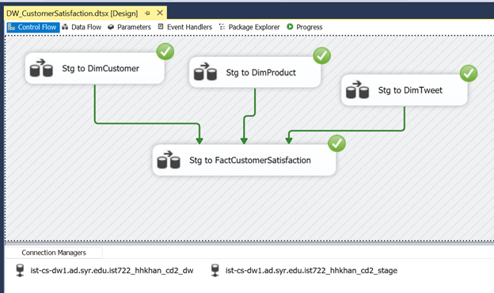
Stage to Data Warehouse

Slide 13

Business Intelligence

Slide 14
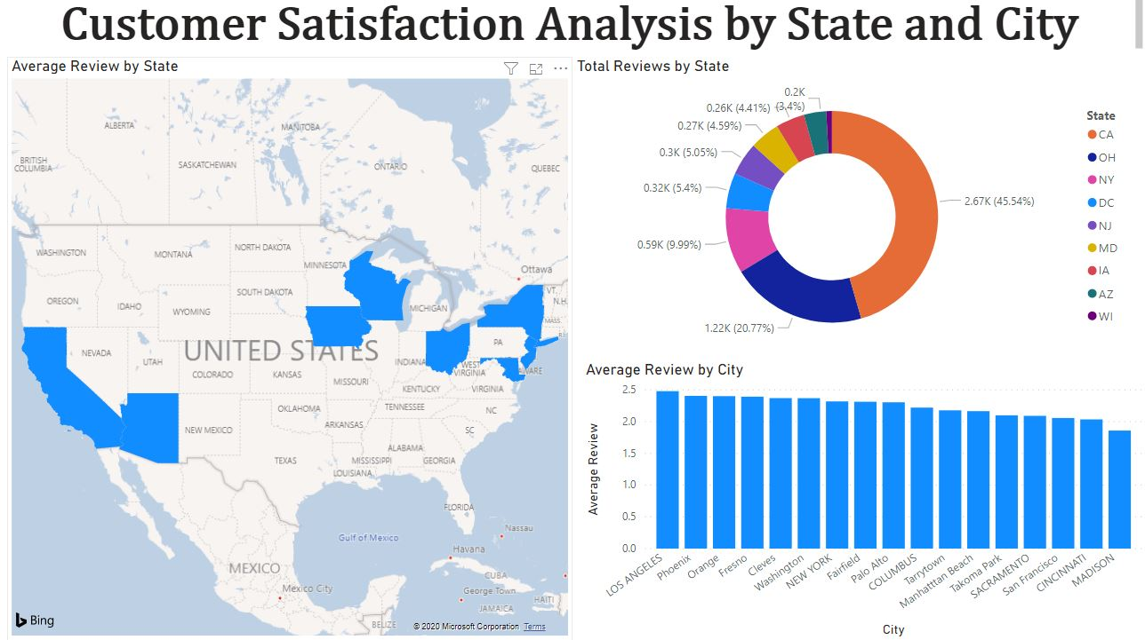
Fudgemart Visualizations

Slide 15
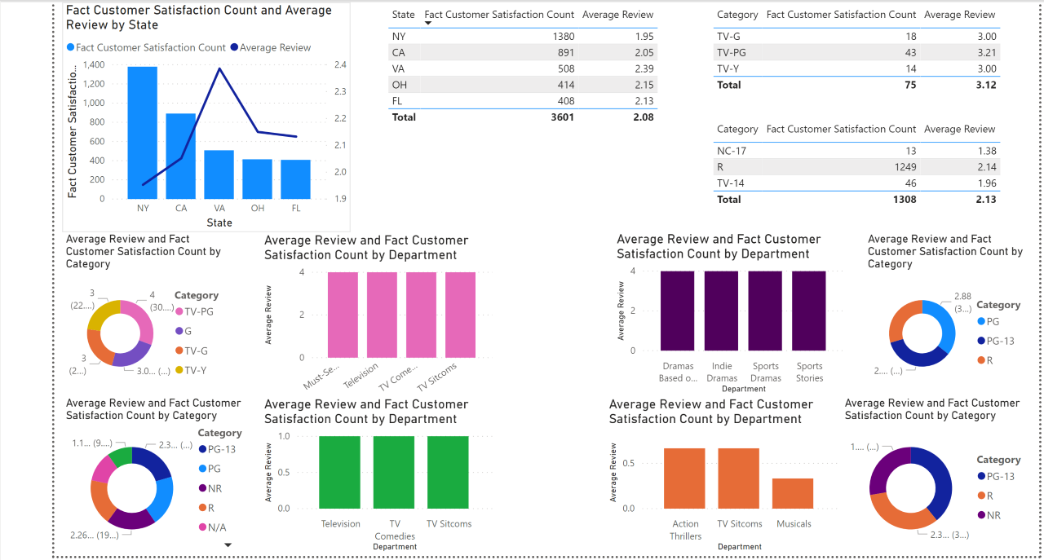
Fudgeflix Visualizations

Slide 16
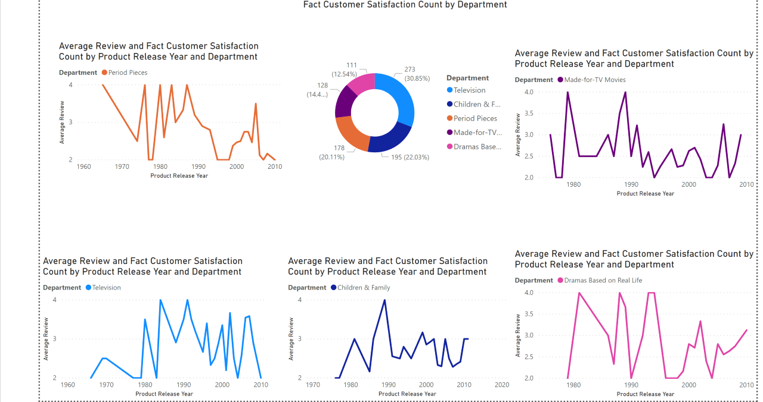
Fudgeflix Visualizations

Slide 17
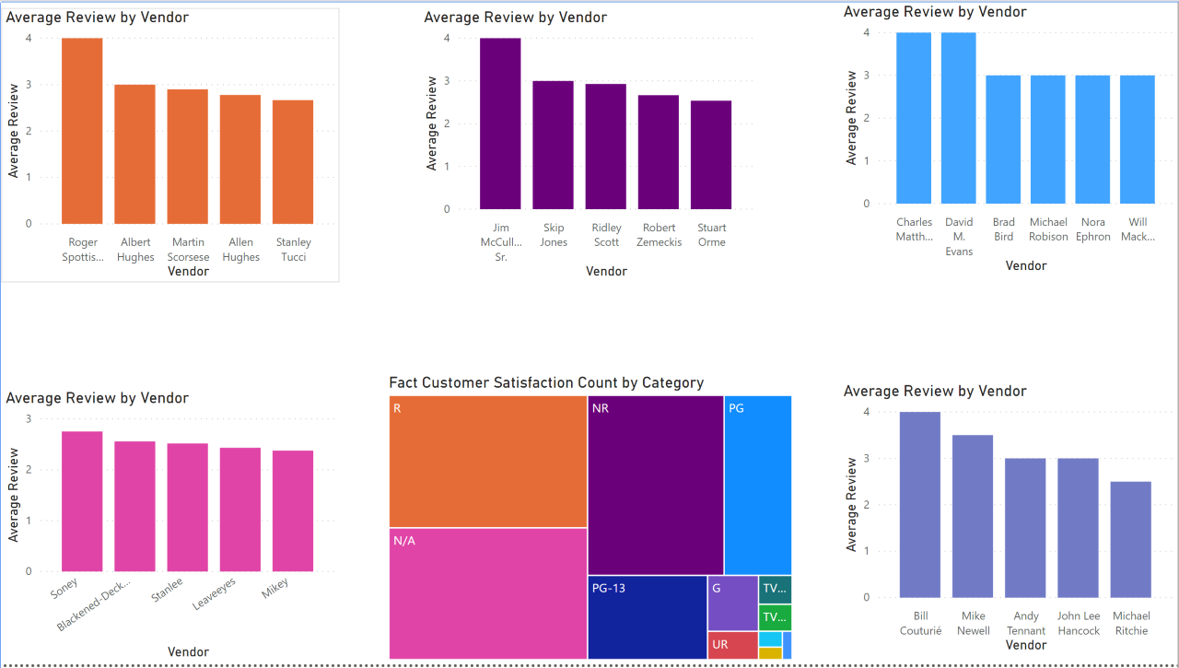
Fudgeflix Visualizations

Slide 18
Fudgeflix Visualizations

Slide 19
Our recommendations
Fudgemart
Fudgeflix
Tweet

Slide 20
Thank you!
We are open to questions.

